Slide 1
Welcome
to
sunbeam

Slide 2


Sunbeam Institute of Information Technology

Slide 3
Project Report On
AWS INFRASTRUCTURE COMPLIANCE SECURITY
Submitted in fulfillment for the award of
Post Graduate Diploma in IT Infrastructure System & Security (PG-DITISS) from Sunbeam
(Pune)
Guided By:
Mr. Sandeep Walvekar
Co-Coordinator:
CEO:
Mr. Vishal Salunkhe
Mr. Nitin Kudale

Slide 4
 | Presented By:
Sidhhi |  | PRN: 230944223042
Priyanka Kumari |  | PRN: 230944223028
Kusalkar Isha Maruti |  | PRN: 230944223018

Slide 5
DECLARATION
We declare that this written submission represents our ideas in our own words and where others ideas or words have been included; we have adequately cited and referenced the original sources. We also declare that we have adhered to all principles of academic honesty and integrity and have not misrepresented or fabricated or falsified any idea/data/fact/source in our submission. We understand that any violation of the above will cause for disciplinary action by the Institute and can also evoke penal action from the sources which have thus not been properly cited or from whom proper permission has not been taken when needed.
Priyanka Kumari 230944223028
Place: Pune
Sidhhi 230944223042
Date: 22-02-2024
230944223018
Kushalkar Isha Maruti

Slide 6
CERTIFICATE
TO WHOM SO EVER IT MAY CONCERN
This is Certify that
Sidhhi PRN: 230944223042
Priyanka Kumari PRN:230944223028
Isha Kushalkar Maruti PRN: 230944223018
Have successfully completed their project on
“AWS INFRASTRUCTURE COMPLIANCE SECURITY”
Co-Coordinator
Mr. Vishal Salunkhe
Under the guidance of
Mr. Sandip Walvekar

Slide 7
Aws Infrastructure Compliance Security
INTRODUCTION
Aims and Objective:
Automating security compliances Infrastructure on AWS.
Objectives:
Automate server deployment
Automation of security and compliances

Slide 8
Aws Infrastructure Complince Security
This project run compliance Security checks on AWS Infrastructure which includes AWS foundational Best Practises ,CIS Benchmark and PCI DSS framework with the help of security hub.
Eg.- when a Administrator make any changes to infrastructure or add any new services to infrastructure whether it is compliance or not according to compliance framework t.hat can be monitored through Security Hub.

Slide 9
AWS CONFIG
AWS SECURITY
HUB
FINDINGS
AWS CLI
JENKINS
DEFECT DOJO
Diagram

Slide 10
AWS CONFIG:-Enable to access ,audit and evaluate config. of AWS resources.
FINDINGS:- According to the findings Security level imidiate actions can be taken for the higher level security findings .
SECURITY HUB :- Security hub tools shows this findings as graphical interface with severity level but at organisatinational level we can not represent like this .
We have to present in the form of a proper report that’s why we have used Defect Dojo.
Defect Dojo:- it is third party open source tool which can be integrated with security hub and it generates repoert which can be customized according to our need.
AWS CLI:- it is command line tool of aws which allow to intractact with aws services directly from terminal or command prompt.
JENKINS:- jenkins is java based open source automation platform with plungins designed for continuous integration .it is used to continually cretae and test software projects.

Slide 11
WORKING OF PROJECT
AWS SECURITY HUB
AWS Security Hub is a comprehensive security management service provided by Amazon Web Services (AWS) to help users centrally manage and prioritize security findings across their AWS environment. It acts as a hub foraggregating, organizing, and prioritizing security alerts and findings from various AWS services and third-party integrations. AWS
SECURITY HUB
AWS Security Hub is a comprehensive security management service provided by Amazon Web Services (AWS) to help users centrally manage and prioritize security findings across their AWS environment. It acts as a hub for aggregating, organizing, and prioritizing security alerts and findings from various AWS services and third-party integrations.

Slide 12
AWS Findings
AWS Security Hub continuously evaluates the configuration settings of your AWS resources against a set of predefined security standards and compliance benchmarks. Security Hub aggregates findings from multiple AWS services that perform compliance checks.
AWS Command Line Interface (CLI)
The AWS Command Line Interface (CLI) is a unified tool provided by Amazon Web Services (AWS) that allows you to manage various AWS services and resources from the command line of your terminal or command prompt . Through AWS CLI, we logged in in our terminal with the credential of AWS IAM Administrator who has given a programmatic access. With the help of AWS CLI we gathered all the findings generated in the security hub after running compliance check on different frameworks. These findings are stored in a JSON format

Slide 13
Defectdojo
The next step is integration of Defect dojo with the AWS Security Hub, for this Defect dojo provides add product option where we can add different tools to integrate with Defect dojo. We added Security hub and then engagement is created to parse to all the findings generated through AWS Security Hub . In order to parse the findings from security hub in Defect dojo we have used HTTP Post method . After gathering all the findings from AWS CLI in JSON format, through HTTP Post method this json file is parsed to Defect dojo.
We have created a Linux shell Script to automate this process of gathering all the findings in json file and then parsing this findings to Defect dojo through HTTP Post method.
Jenkins
This whole process is automated with Jenkins. In order to integrate jenkins server with AWS Security Hub we have created a role and gave full access of AWS Security Hub to Jenkins server. We have use AWS Credential plugins in Jenkins. Whenever new findings or failed security check occur at AWS Security hub according to compliance framework Jenkins will automatically use build trigger and automatically creates a json file and
parse this findings to defect dojo so that we Can Continuously monitor AWS
Infrastructure Security Checks.

Slide 14
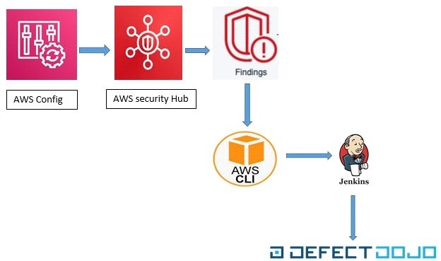

Slide 15
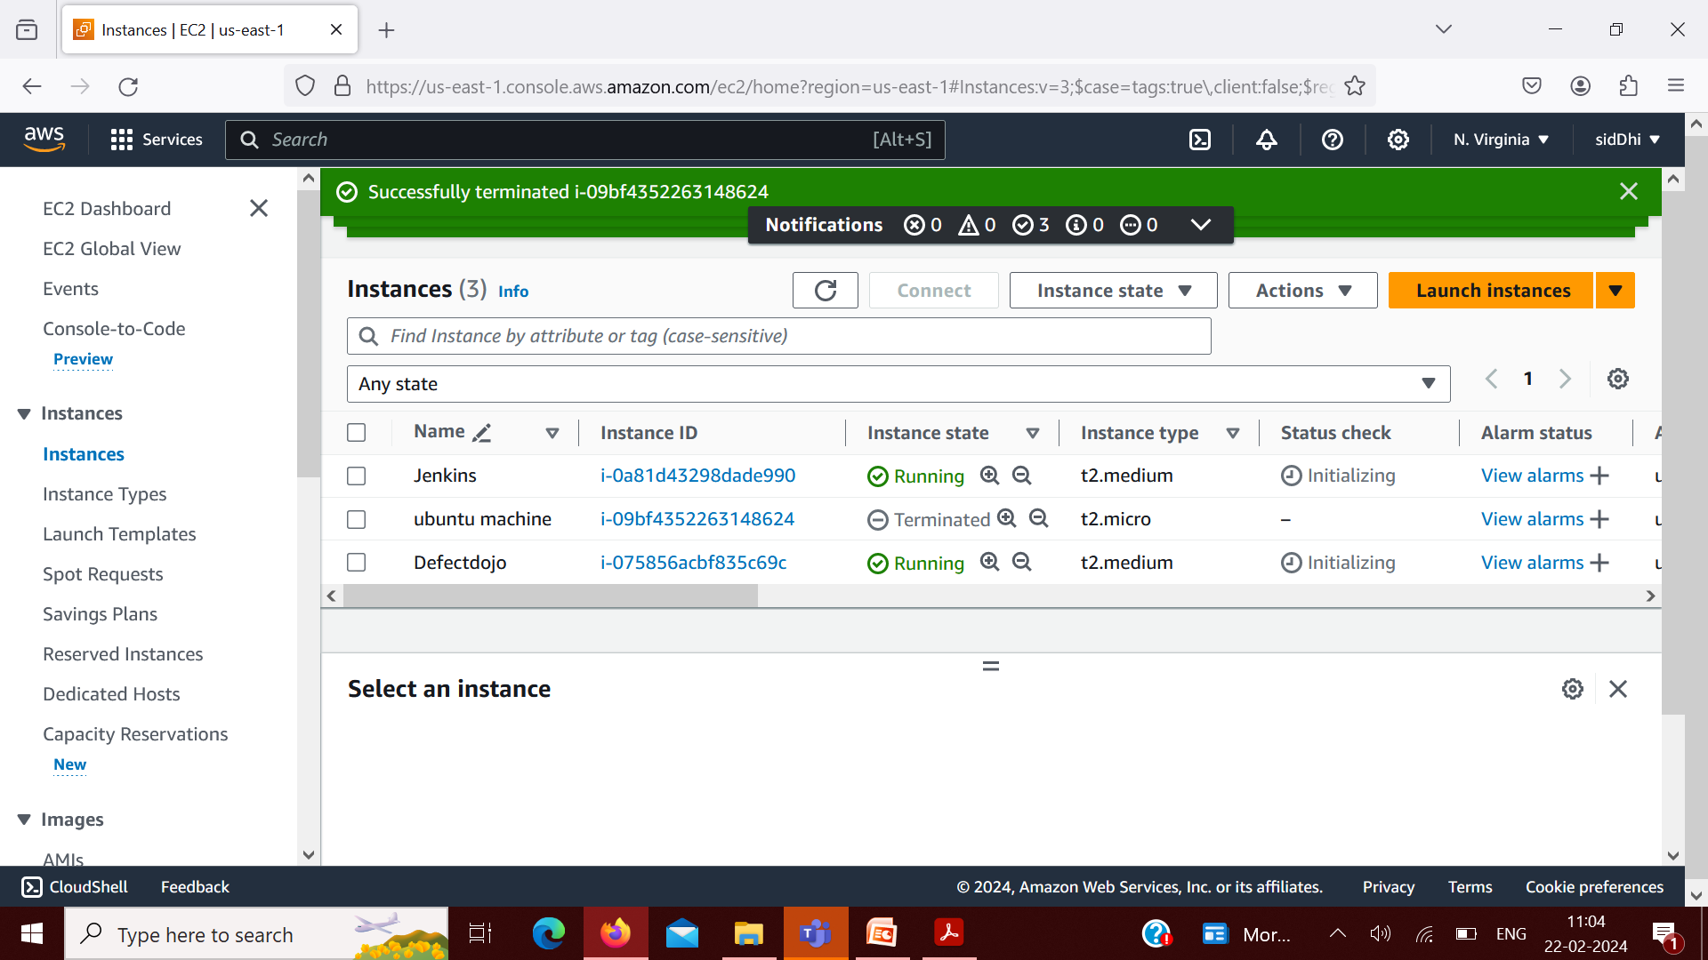
SCREENSHOTS
Ec2

Slide 16
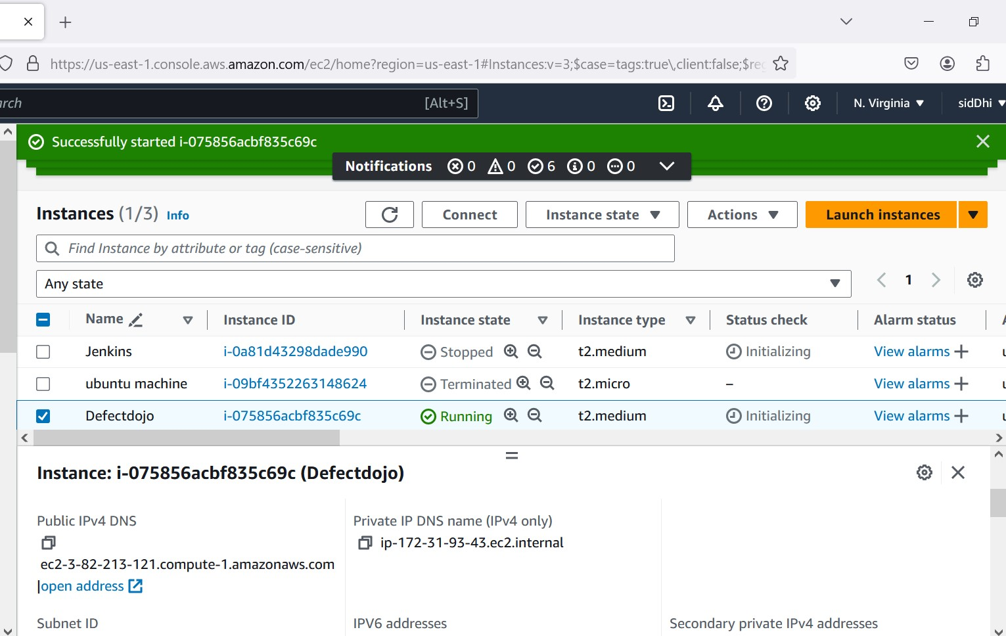
Running Ec2 Instances

Slide 17
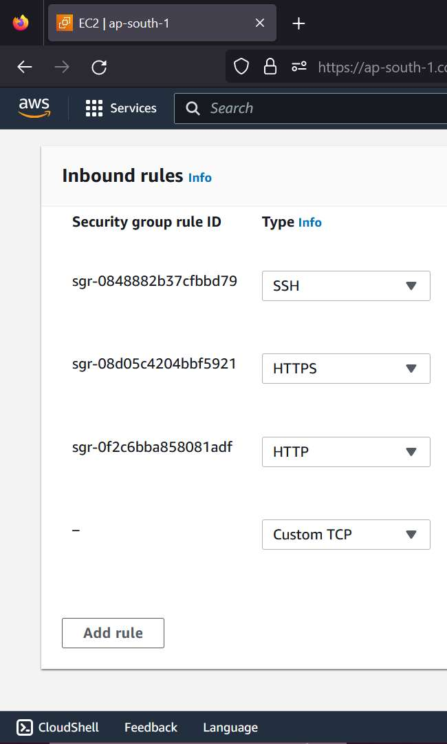
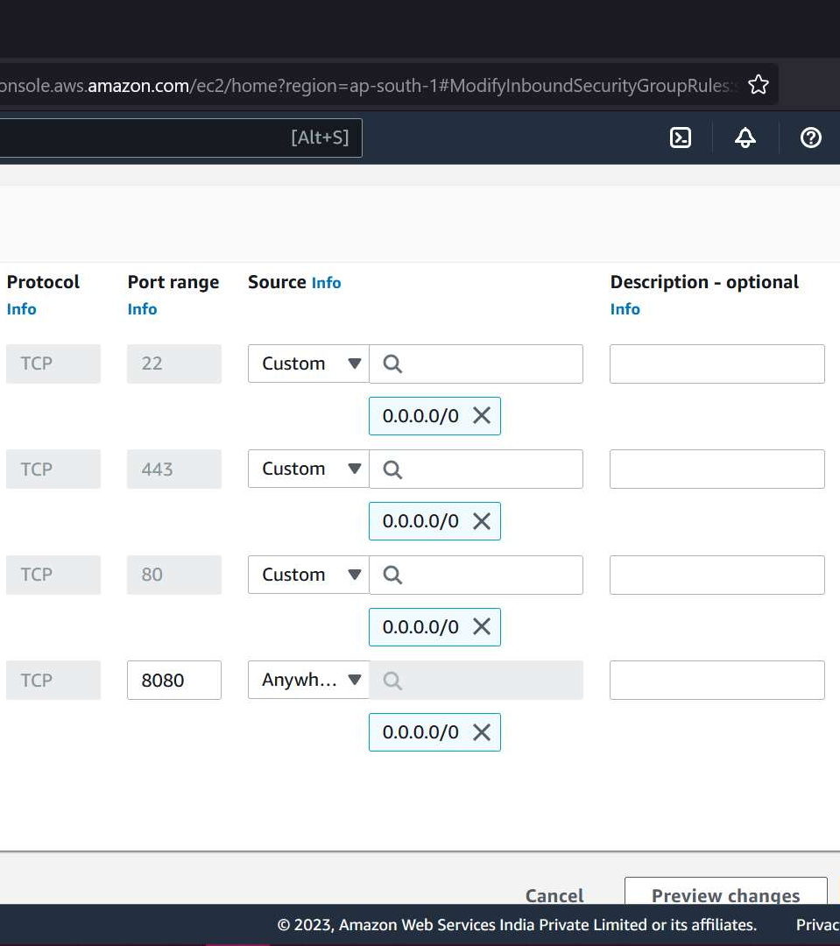
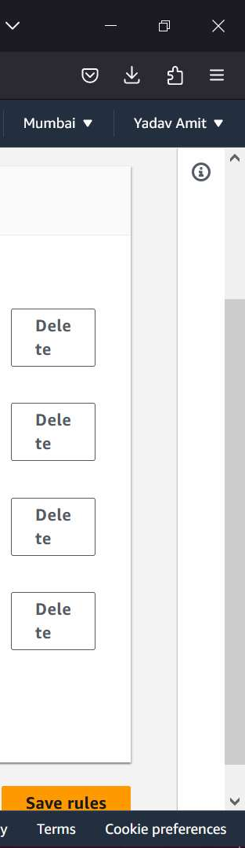
Adding TCP Rule to Inbounds Rule

Slide 18
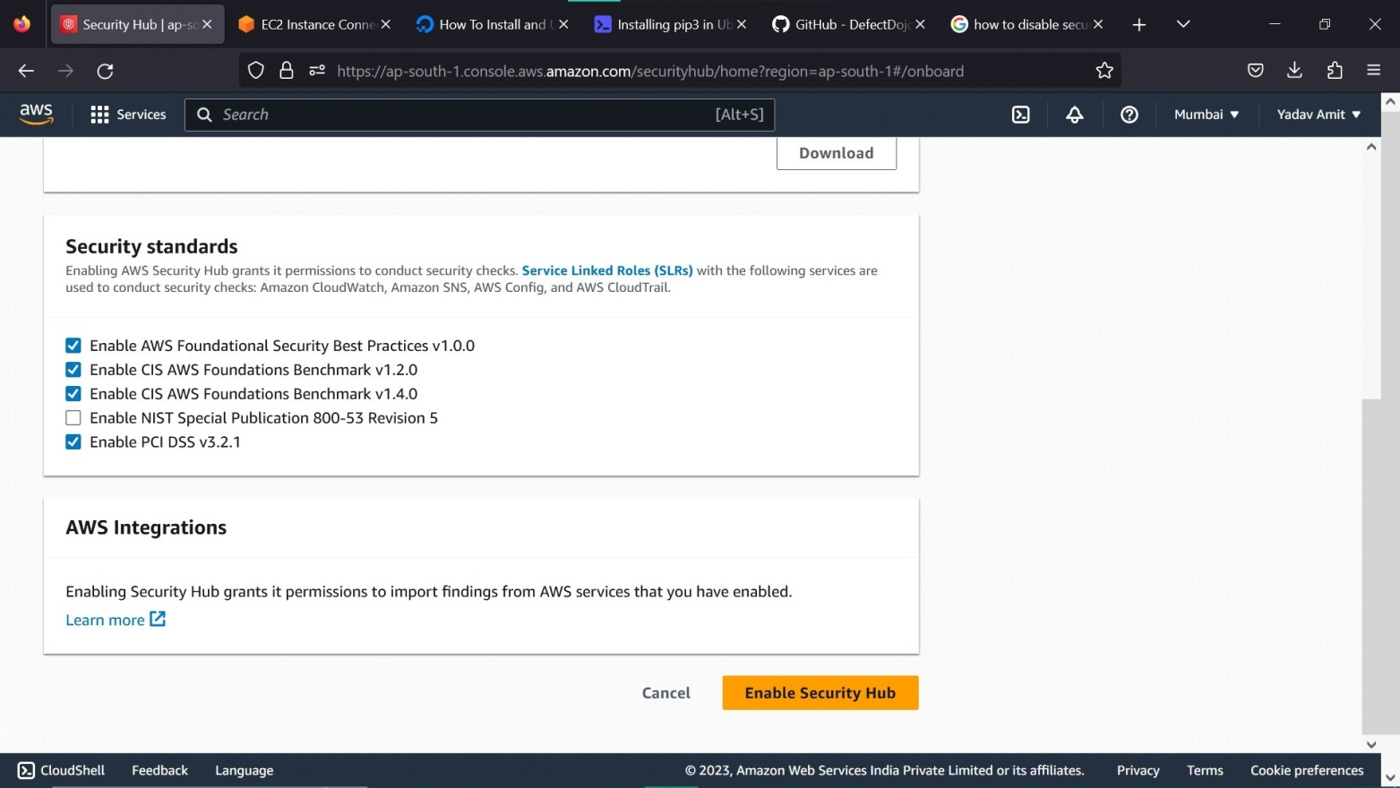
Enable Security Hub

Slide 19
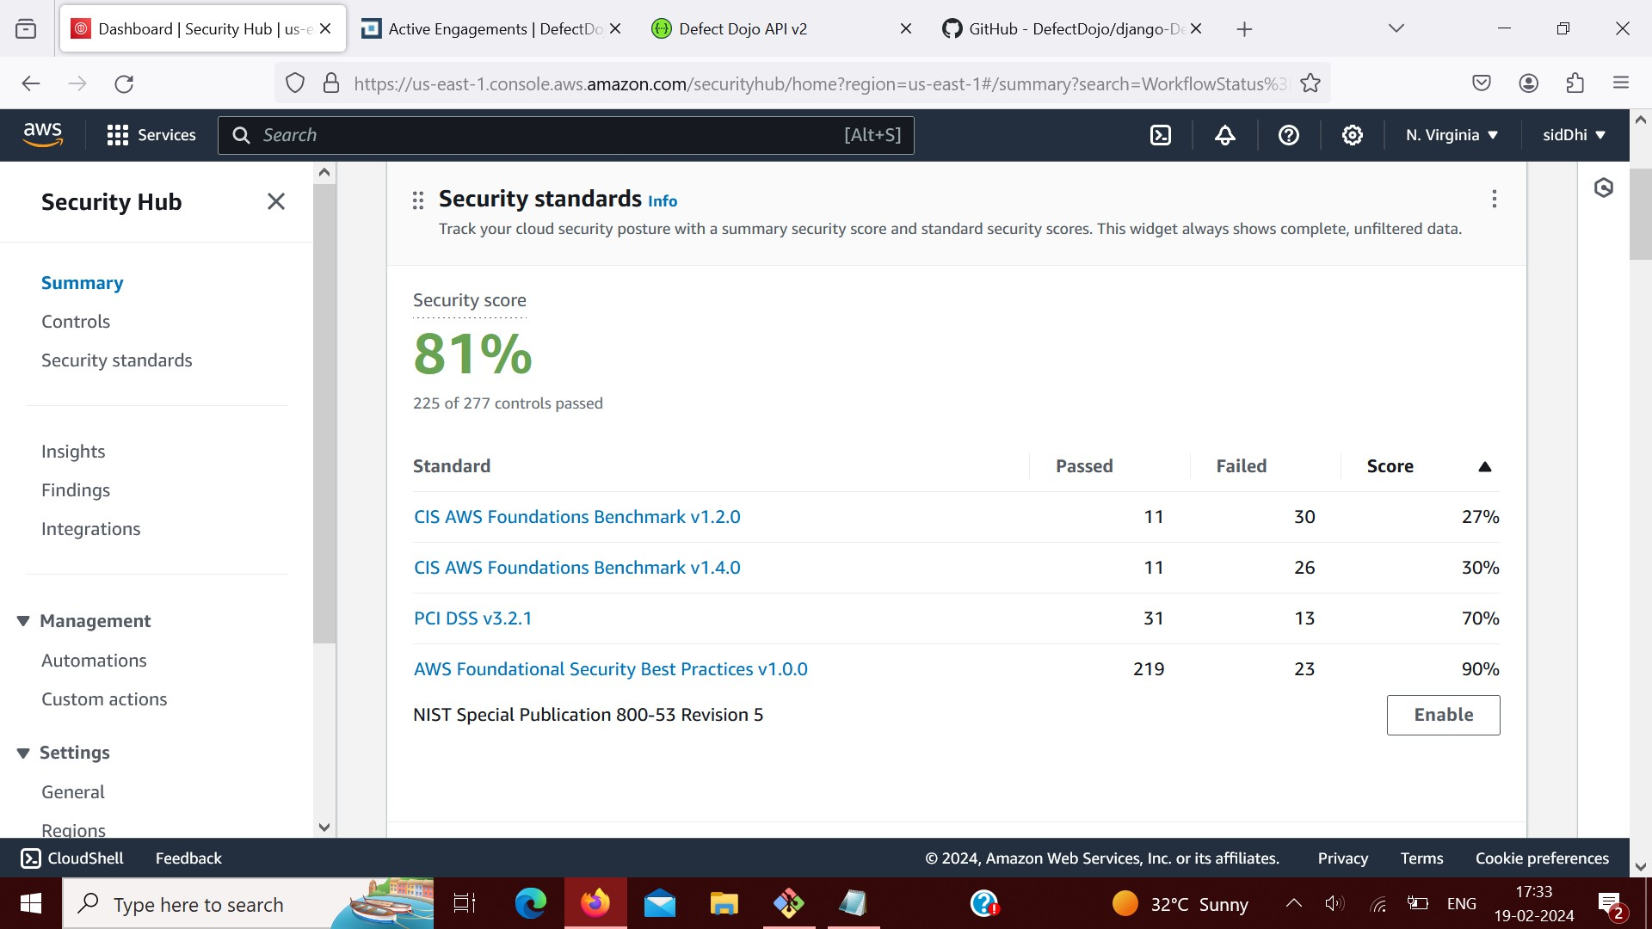

Slide 20
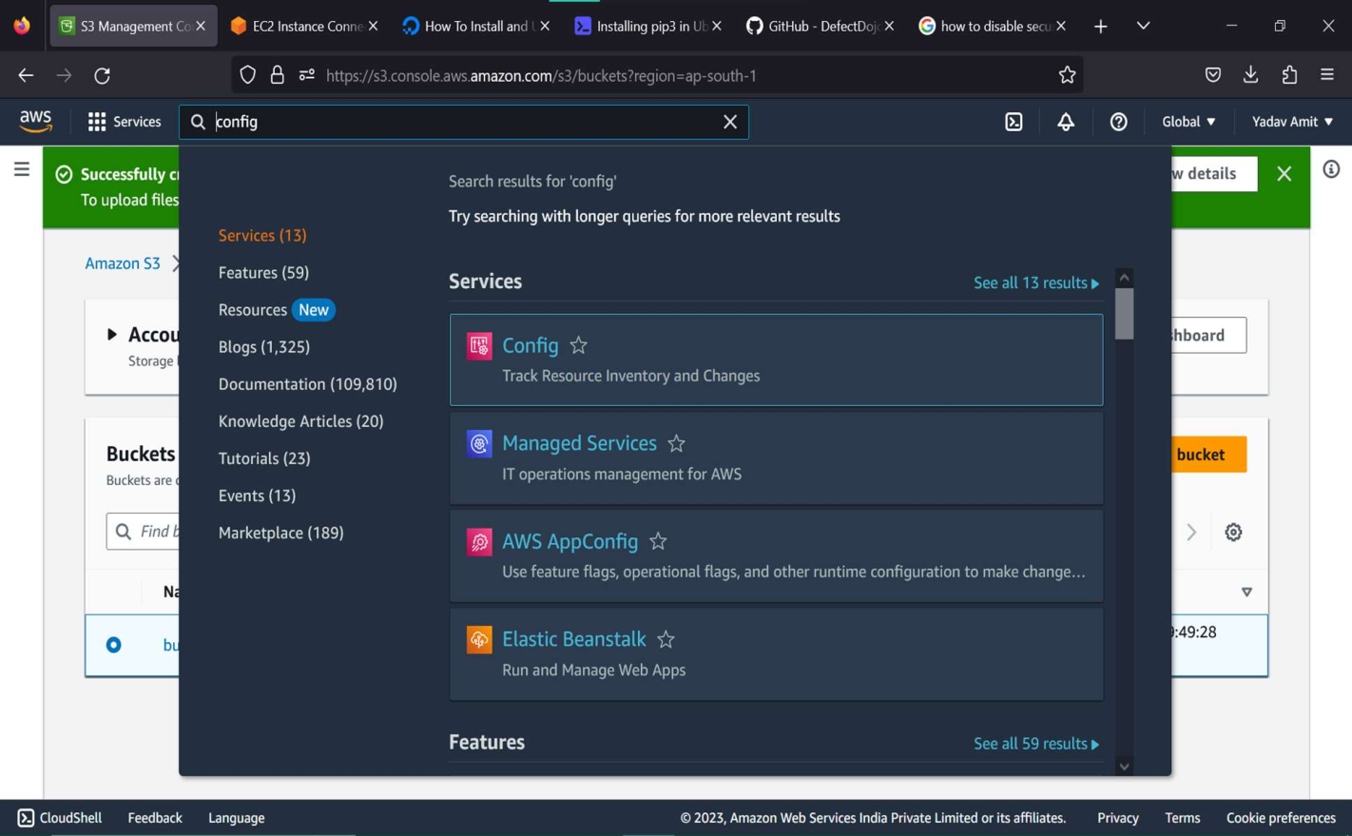
Enable Config for Active

Slide 21
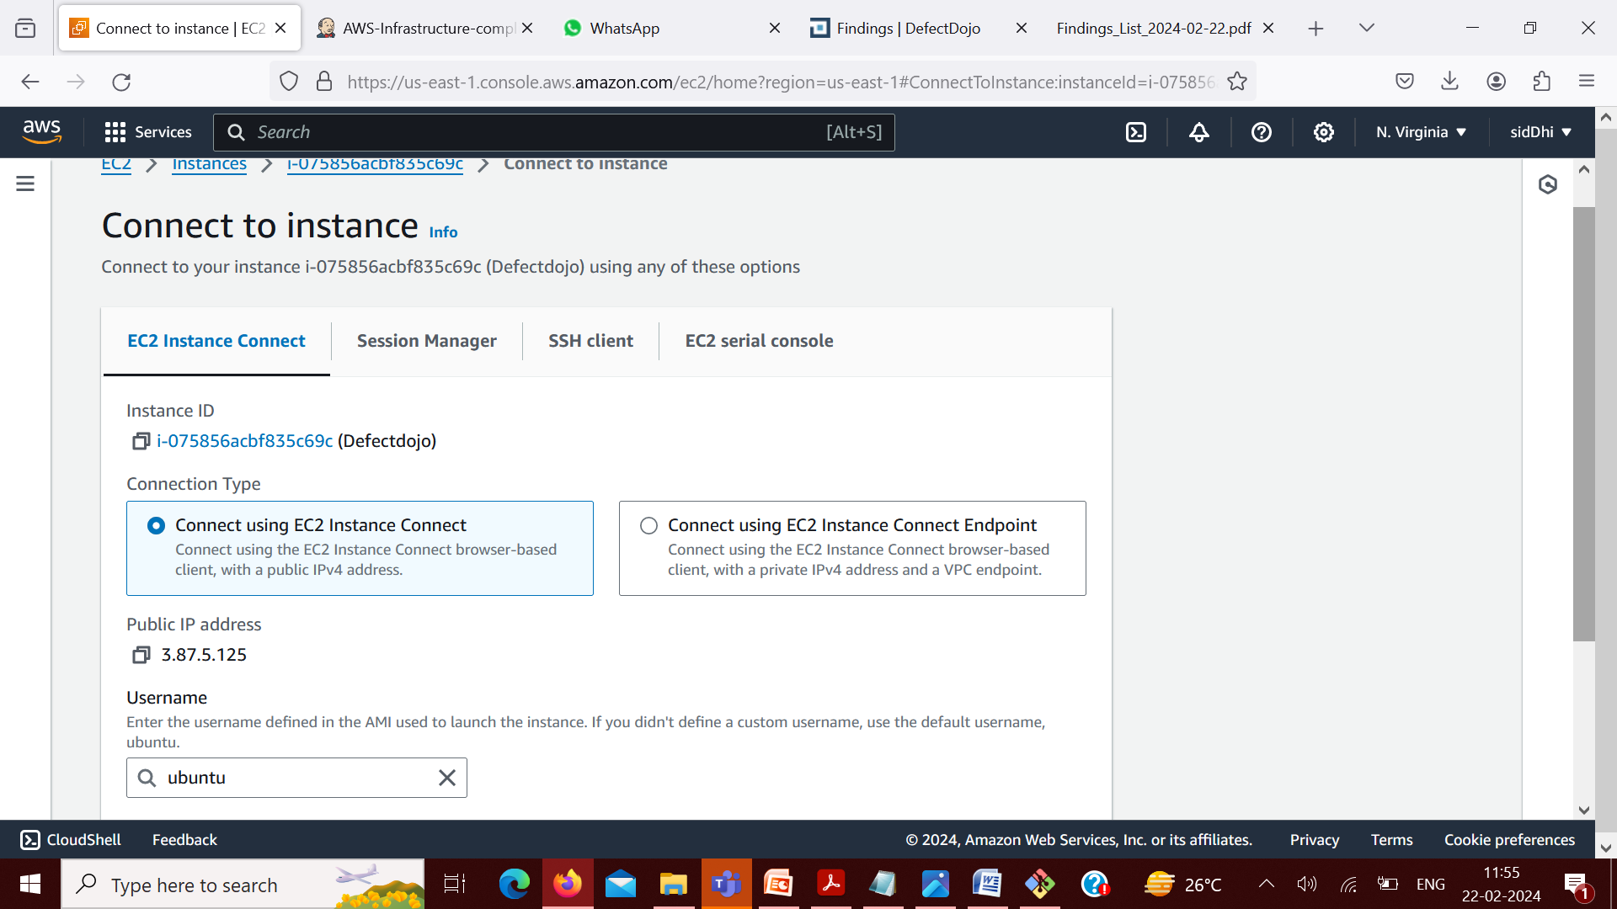
Start The Ubuntu and Connect to the Terminal

Slide 22
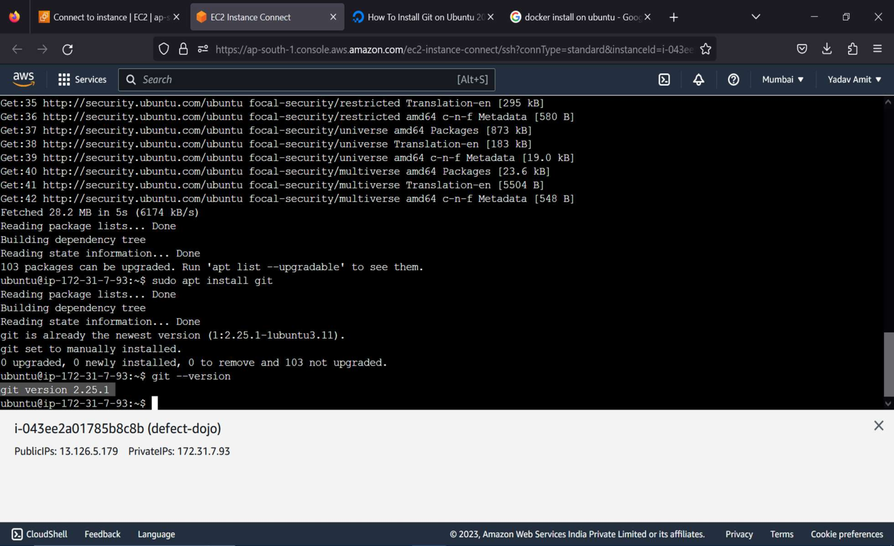
Install Git

Slide 23
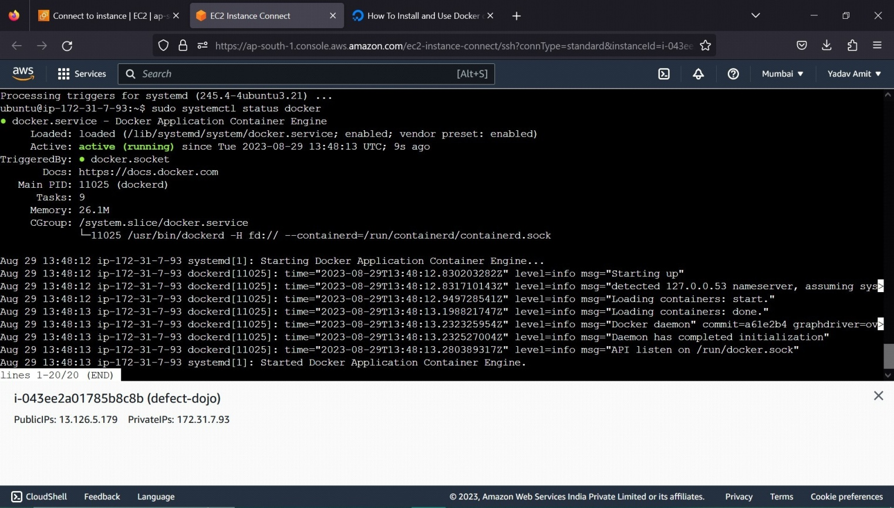
Install docker and docker compose

Slide 24
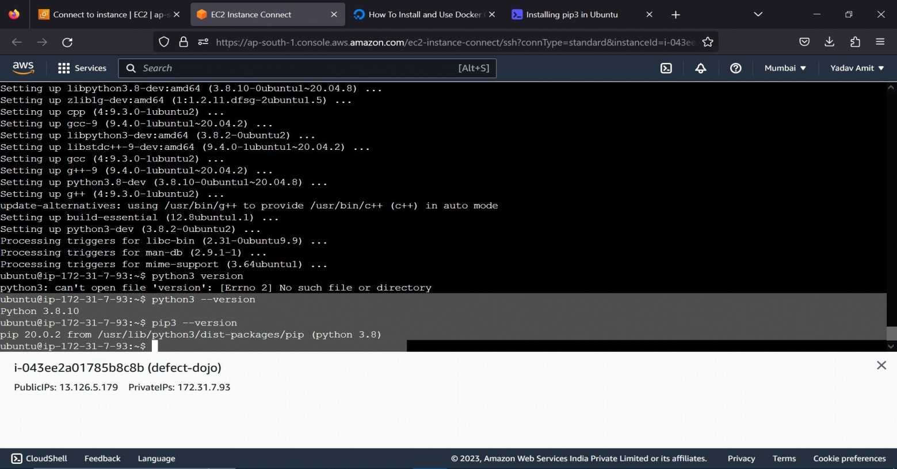
Install Python3 and Pip3

Slide 25
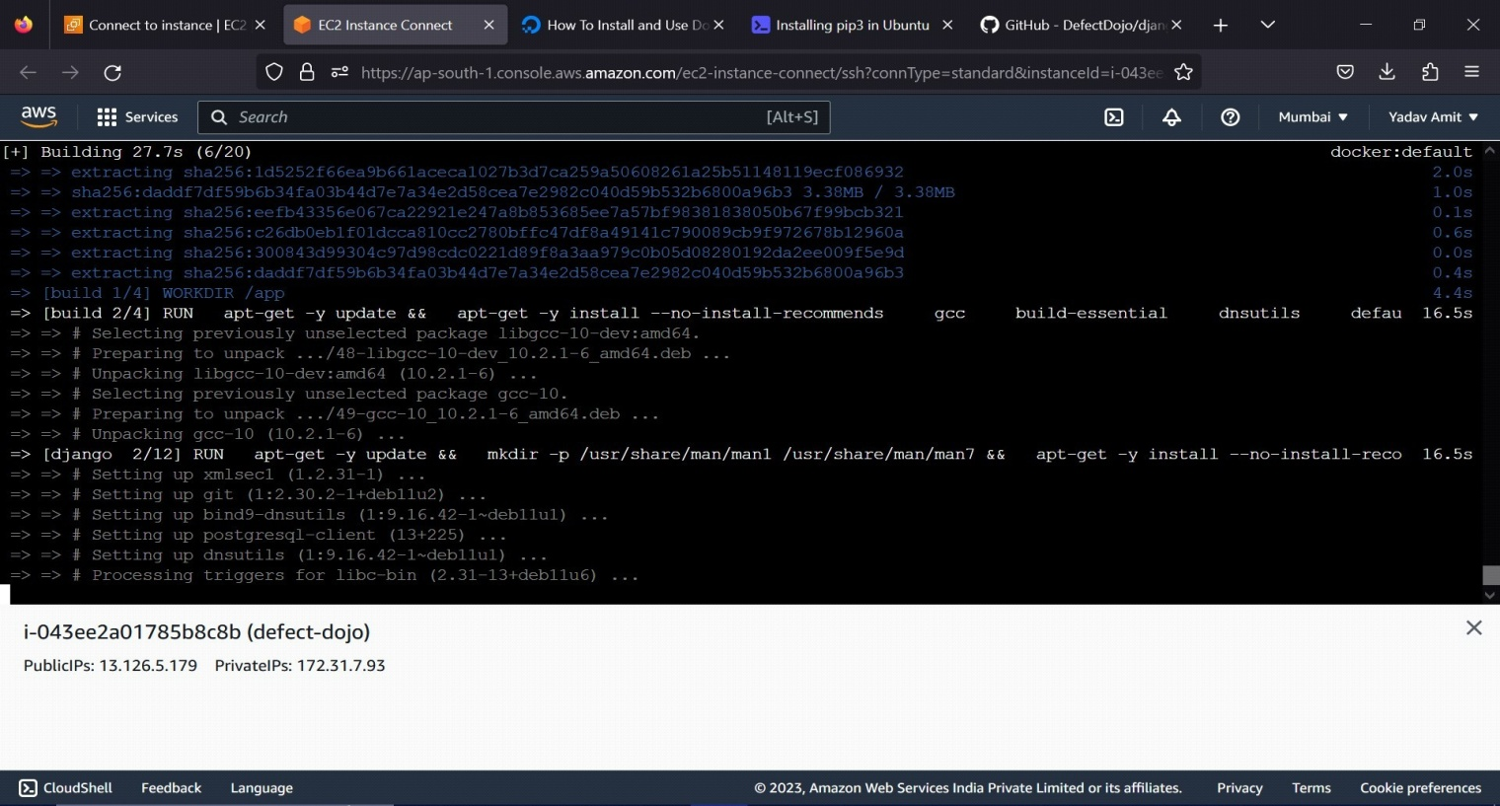
Clone Defect-Dojo From Github Git clone

Slide 26
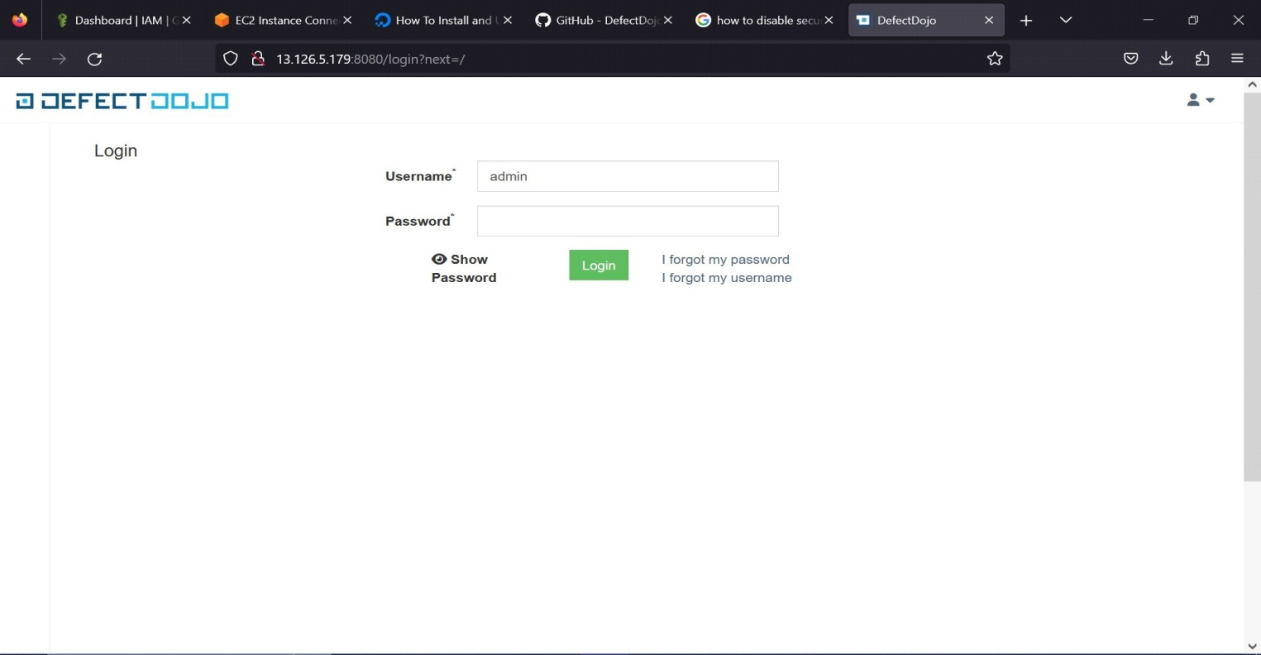
Login Defect-Dojo in Localhost and grep the admin password from docker compose logs initializer

Slide 27
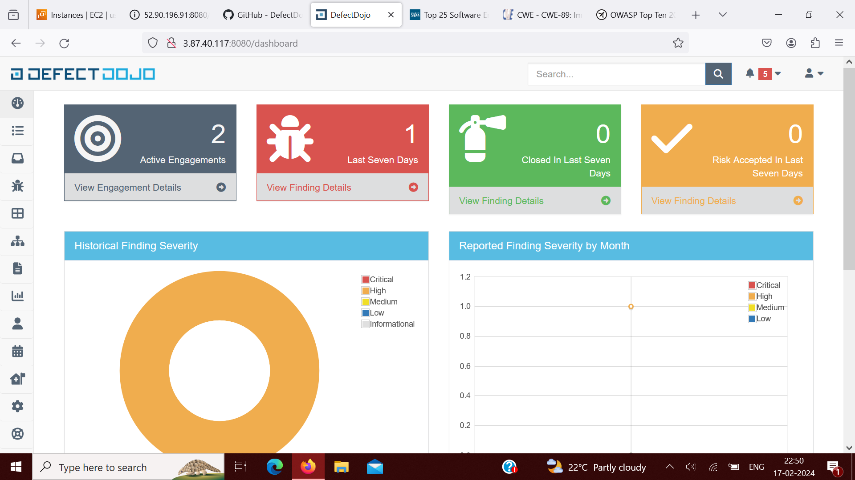
Defect-Dojo Dashboard

Slide 28
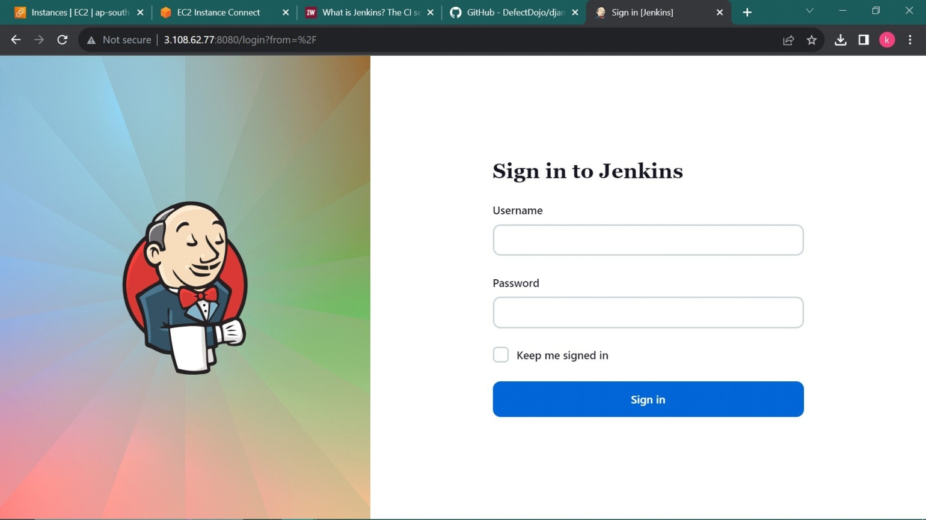
Jenkins Login Page

Slide 29
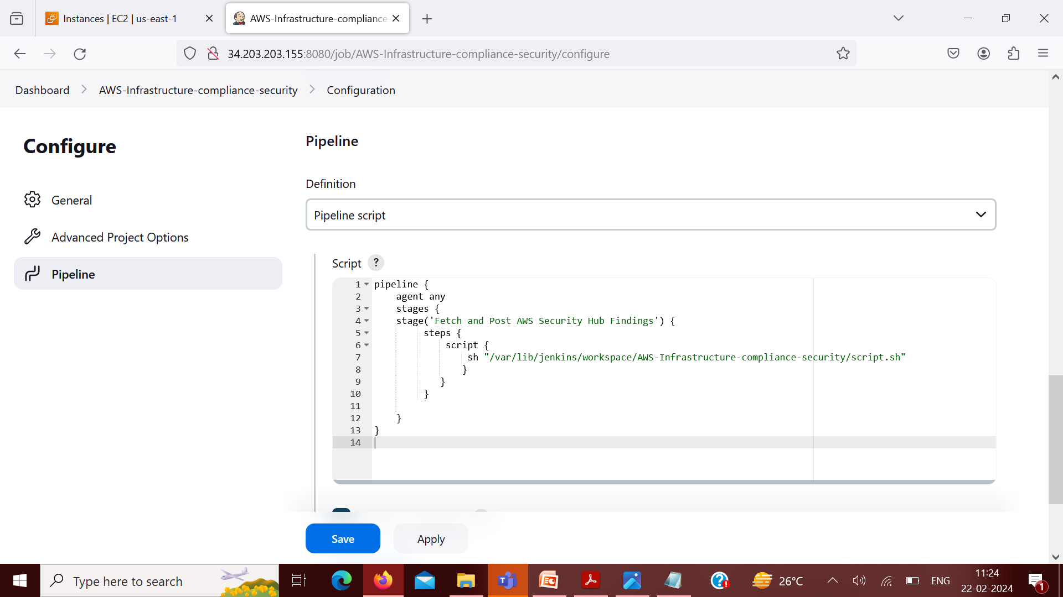
Jenkins Pipeline

Slide 30
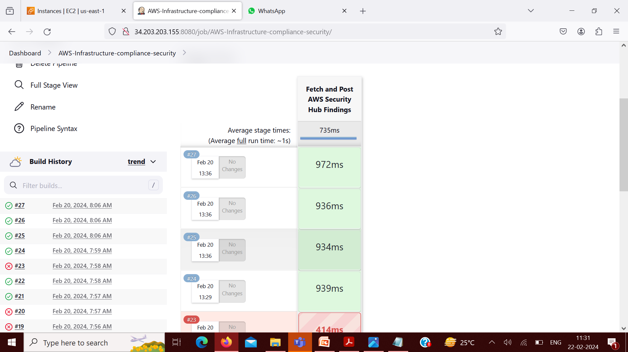
Jenkins pipeline

Slide 31
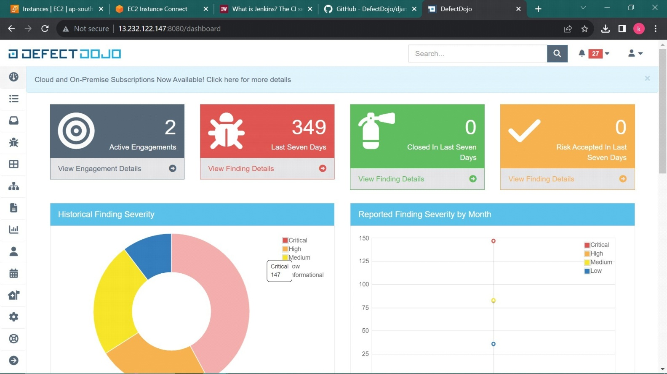
Defect-Dojo Output

Slide 32
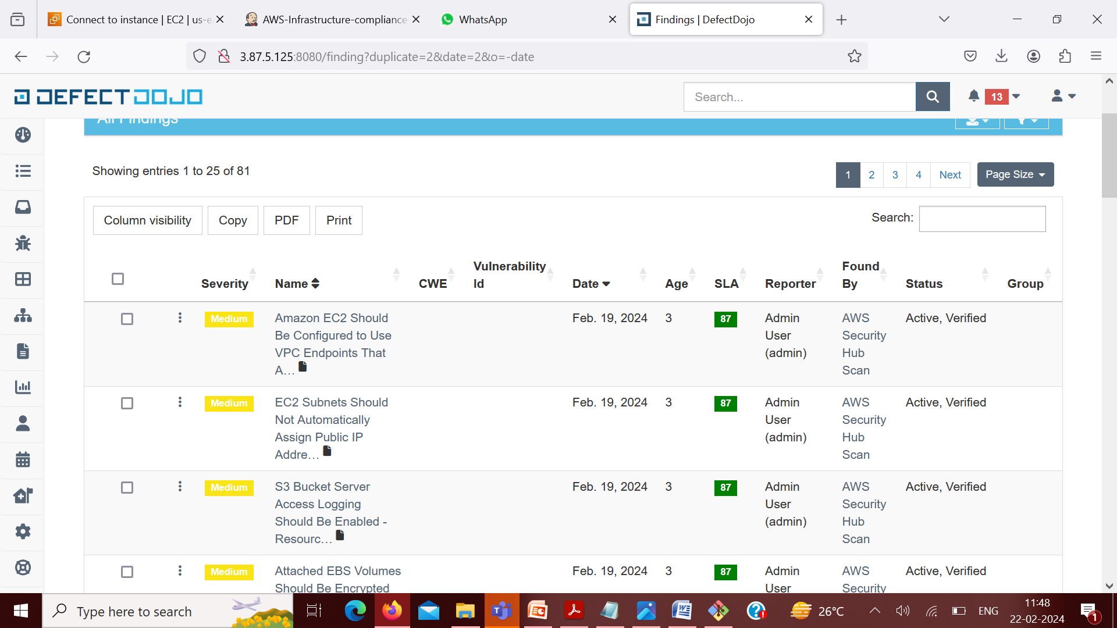

Slide 33
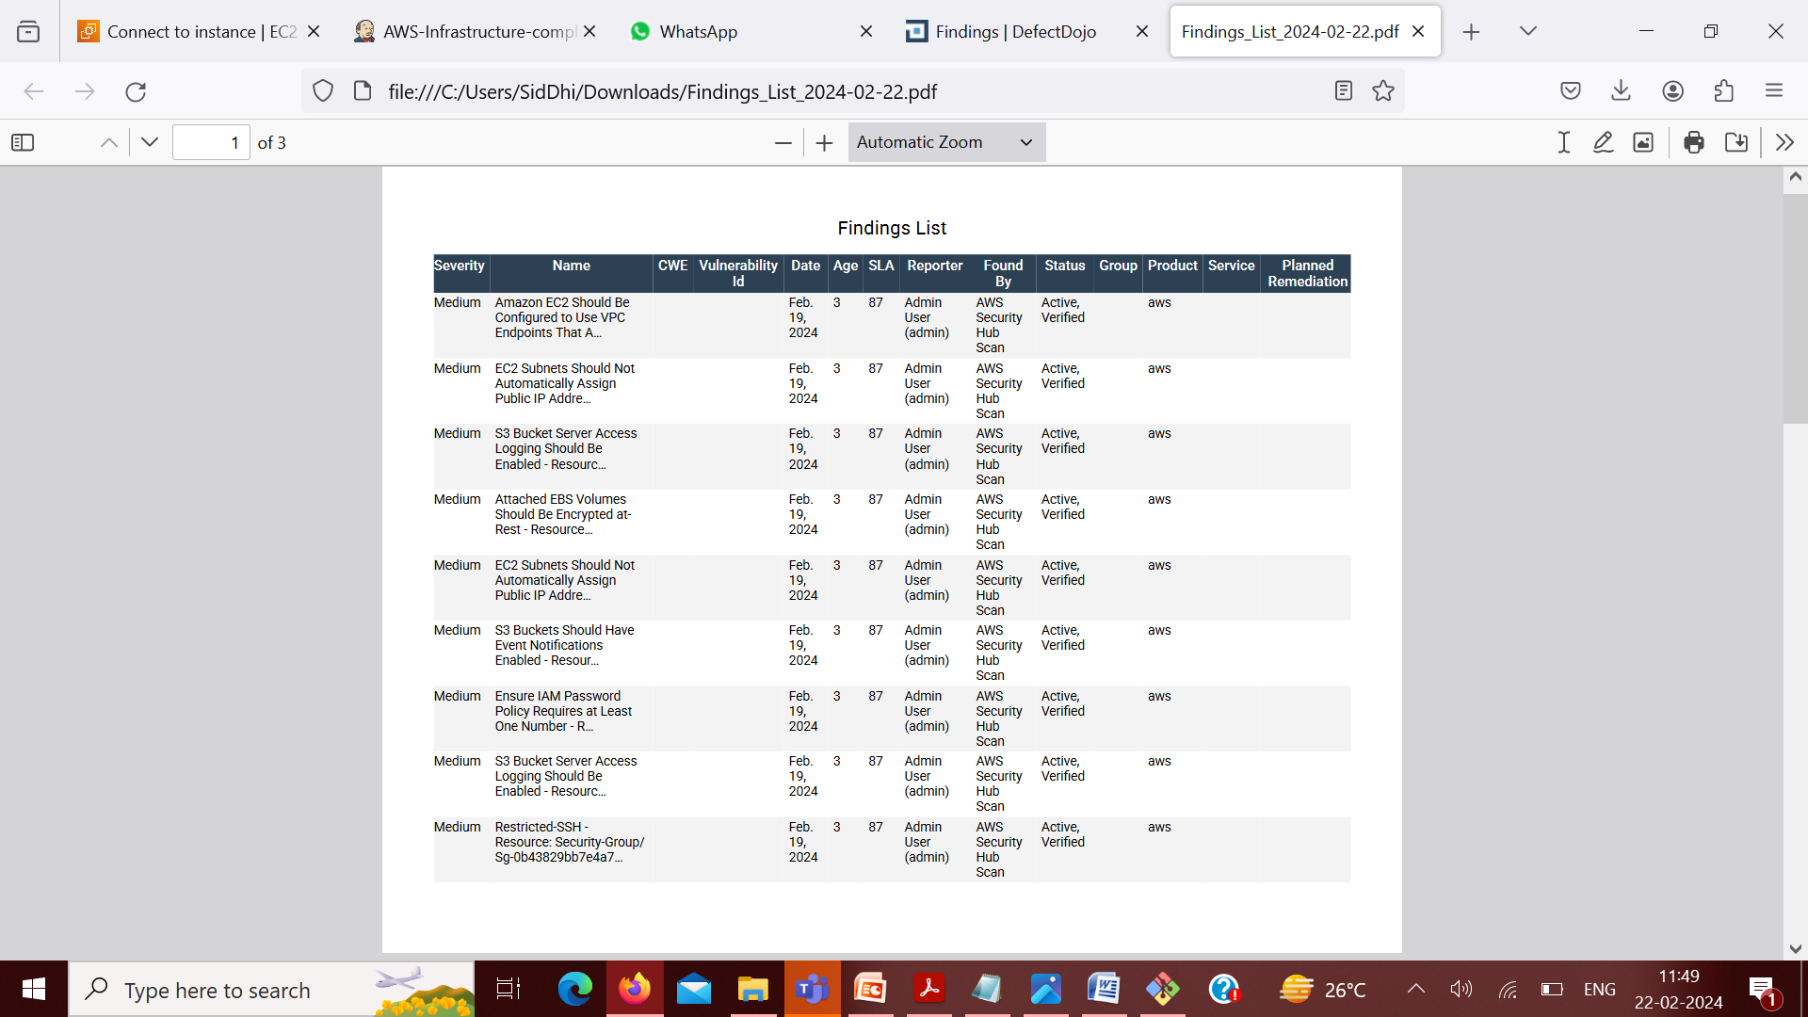
Generate a Reports

Slide 34
CONCLUSION & FUTURE SCOPE
Conclusion:
A secure AWS Infrastructure is assured with the compliance checks and audit ready report generated
in order to remediate findings and triage vulnerabilities.
Future Scope:
We can add automated and custom remediation by applying rules in AWS lambda for our findings.

Slide 35
THANKS

